Slide 1
Maximizing Revenue of taxi drivers
Through Payment Type

Slide 2
agenda
Problem Statement
Research Question
Data Overview
Analysis & Finding
Hypothesis Testing
Recommendation

Slide 3

Problem statement
In the fast-paced taxi booking sector, making the most revenue is essential for long-term success and driver happiness.
Our goal is to use data driven insights to maximize revenue streams for taxi drivers in order to meet this need.
Our research aims to determine whether payment methods have an impacts on the fare pricing by focusing on the relationship between payment type and fare amount.

Slide 4
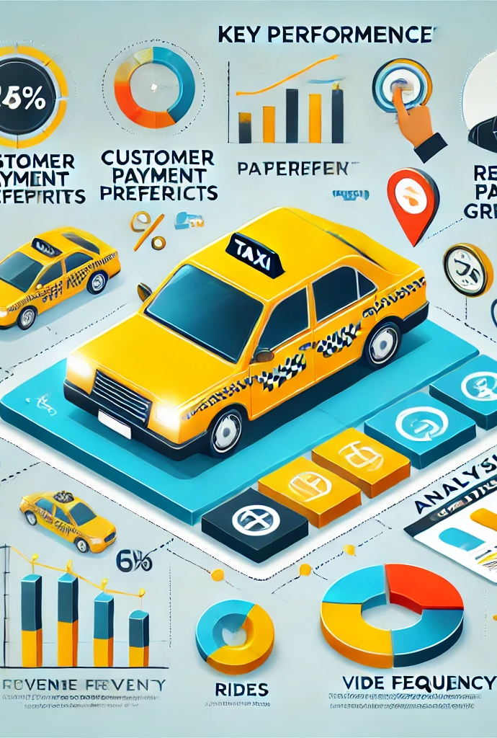
Research Question
Is there a relationship between total fare amount and payment type?
can we nudge costumers towards payment methods that generate higher revenue for drivers, without negatively impacting costumers experience?

Slide 5

Objective
This project's main goal is to run A/B test to examine relationship between the total fare and the method of payment.
We use python hypothesis testing and descriptive statistics to extract useful information, that can help taxi drivers generate more cash in particular, we want to find out if there is a big difference in the fares for those who pay with credit card versus those who pay with cash.

Slide 6
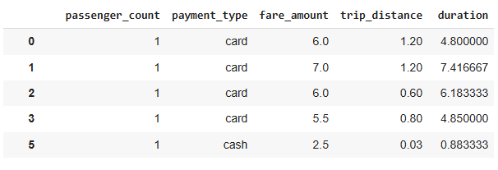
Data Overview
In this analysis, we worked with a detailed dataset of NYC Taxi Trip records. We applied data cleaning and feature engineering techniques to isolate and retain only the columns necessary for our investigation.
Passenger count(1-5)
Payment Type(cash & card)
Fare Amount
Trip Distance(miles)
Duration(minutes)

Slide 7
Methodology
Step | Description
Descriptive Analysis | Perform Statistical Analysis to summarize key aspects of data focusing on fare amounts and payment types
Hypothesis Testing | Conduct T-test to evaluate relationship between payment type and fare amount , testing hypothesis that different payments methods influence fare amounts.
Regression Analysis | Implemented Regression Analysis to explore relationship between trip duration( which is calculate from drop off and pick up time) and fare amount.

Slide 8
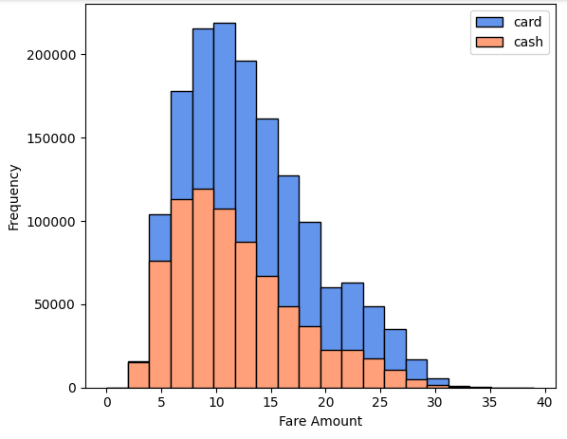
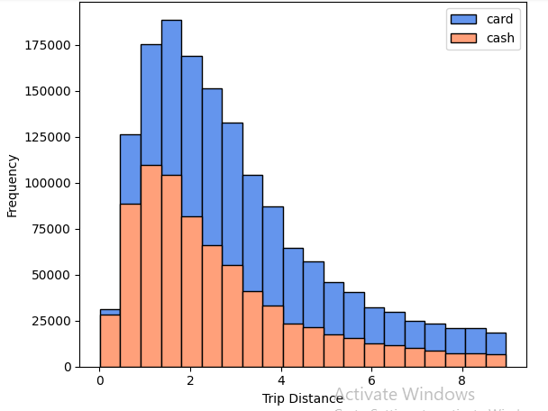
Journey Insights
Costumers paying with cards tend to have slightly higher average trip distance and fare amount compared to those paying with cash
This indicates that costumers prefer pay with card when they have high fare amount and long trip distance
Fare Amount | Trip Distance
 | Payment type | Mean | Std Deviation
Fare Amount | Card | 13.7 | 6.5
 | Cash | 12.25 | 6.2
Trip Distance | Card | 3.23 | 2.32
 | Cash | 2.8 | 2.23

Slide 9
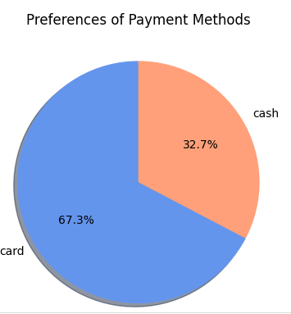
Preference of Payment types
The proportion of customers paying with cards is significantly higher than those paying with cash. Payments with card accounting for 67.5% of all transaction compared to cash payment at 32.5%.
This indicates a strong preference among costumers for using card payment over cash potentially due to convenience, security or incentives offered for card transaction.

Slide 10
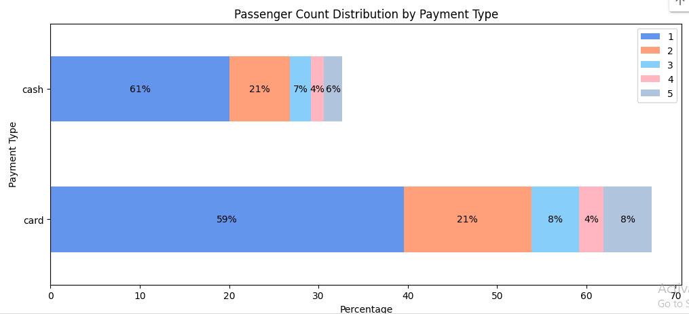
Passenger count Analysis
Single-passenger rides dominate card transactions, accounting for 40.08% of these payments.
Cash payments are also mainly associated with single-passenger rides, which represent 20.04% of all cash transactions.
A decline in transaction percentages is observed as passenger count increases, indicating that larger groups may prefer other transportation options or payment methods.
These findings highlight the importance of examining both payment type and passenger count in transaction data analysis, as they reveal key insights into customer behavior and preferences.

Slide 11
Hypothesis Testing
Null hypothesis: There is no difference in average fare between customers who use credit cards and customers who use cash.
Alternative hypothesis: There is a difference in average fare between customers who use credit cards and customers who use cash.
With a T-statistic of 165.5 and p value of less than o.o5, give enough evidence to reject null hypothesis, indicating that there is significant difference in average fare between two payment methods

Slide 12
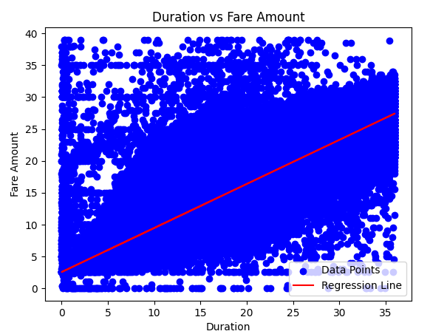
Regression analysis
Intercept (2.527): The intercept represents the estimated fare amount when the trip duration is zero. In this context, it could be thought of as a base fare or fixed starting charge for any taxi trip, regardless of trip length.
Slope (0.692): The slope indicates that for each additional unit of trip duration (e.g., one minute), the fare amount is expected to increase by approximately 0.692 units (e.g., dollars). This positive relationship suggests that longer trips are associated with higher fares.
R-squared (0.76): The R-squared value of 0.76 means that about 76% of the variability in fare amount can be explained by duration. This is a strong R-squared value, indicating that trip duration is a good predictor of fare amount in this model.
In summary, there is a significant positive relationship between trip duration and fare amount, with trip duration explaining a substantial portion of the variation in fares.

Slide 13
recommendations
Encourage customers to pay with credit cards to capitalize on the potential for generating more revenue for taxi cab drivers.
Implement strategies such as offering incentives or discounts for credit card transactions to incentivize customers to choose this payment method.
Provide seamless and secure credit card payment options to enhance customer convenience and encourage adoption of this preferred payment method.

Slide 14
Thank you
Qadir Ali
qadirakhssg@gmail.com

